Slide 1
Vehicle Loan Default Prediction
by:
Abdulrahman Alrubaiya
Mohammed Alghamdi

Slide 2
Content
Introduction
Tools
Baseline
Feature selection and modeling
Lessons learned

Slide 3

Introduction
Financial institutes are suffering from losses
Striving to achieve better credit scoring model
Predict car loan defaults

Slide 4
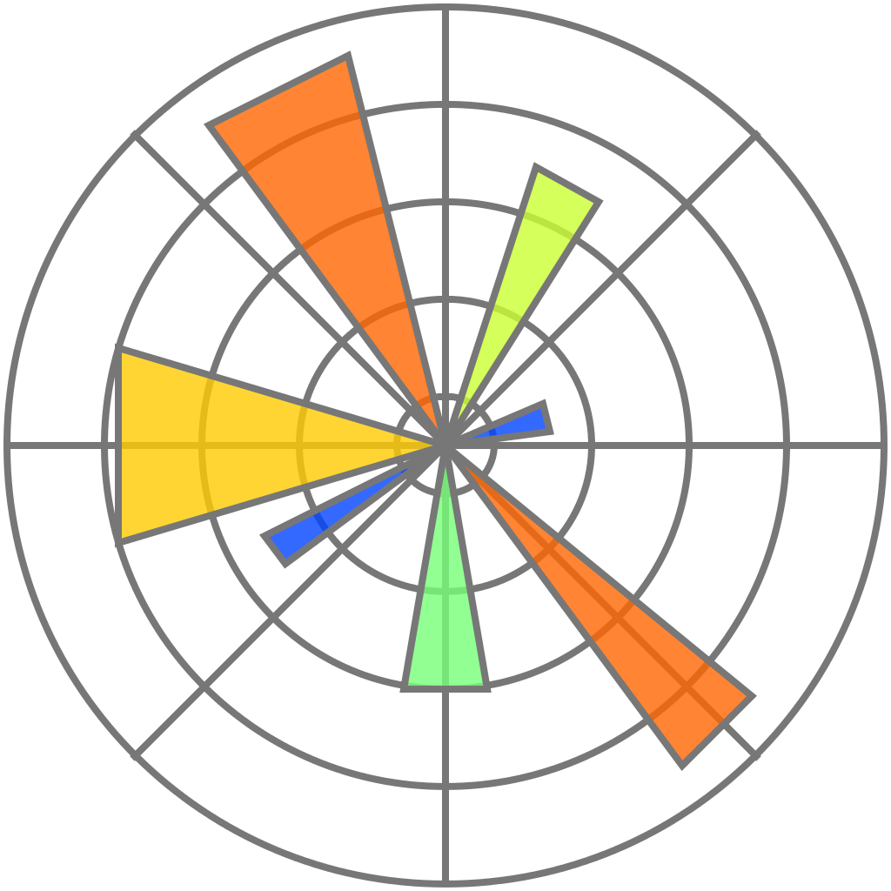



Tools used and frameworks
Python
Pandas
Numpy
Matplotlib, Seaborn
Scikit-learn
Flask
Tableau 2021
Heroku For deployment

Slide 5

Data origins
Obtained from Kaggle
Part of a FinHackathon competition
270k+ rows, 41 columns

Slide 6
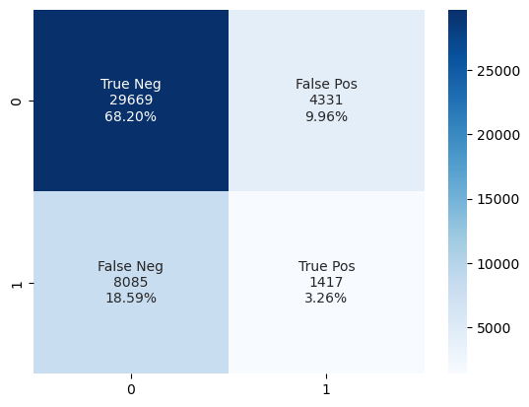
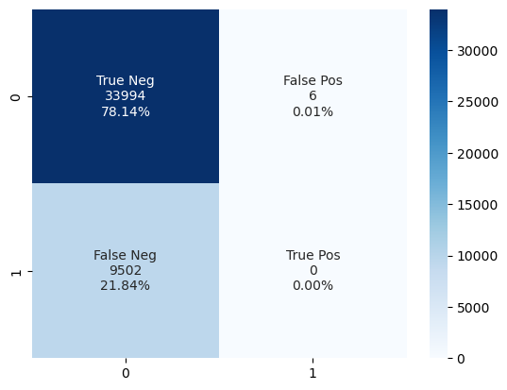
Baseline
Logistic train score: 0.7789
Logistic validation score: 0.7814
KNN train score: 0.8322
KNN validation score:0.7145
KNN confusion matrix
Logistic confusion matrix

Slide 7
Data preprocessing and feature engineering
Date conversion to days
Remove outliers (Upper limit, lower limit, intuitive judgement)
Binning for risk score (Categories)
Create new column out of two features (Loan to asset ratio)

Slide 8

Feature selection
Approach was based on:
Running feature selection techniques:
Lasso model
SelectFromModel (sklearn meta-transformer)
Linear discriminant analysis
Multicollinearity (2 removed in this process)
Variance inflation factor (3 removed in this process)
Business domain knowledge
14 features left

Slide 9
Modeling
Imbalanced (class 1 is ~77% and class 2 is ~33%) 1:3 Ratio
Oversampling (Using SMOTE)
GridsearchCV
Models:
Logistic Regression
Random Forest
KNN
Voting Classifier
XGBoost

Slide 10
Logistics Regression
Accuracy
F1
Precision
 | Accuracy | Precision | Recall | F1
Train | 0.64 | 0.64 | 0.64 | 0.63
Validation | 0.46 | 0.69 | 0.46 | 0.50
I am 69% correct in predicting class 1
I correctly classified 46% of class 1

Slide 11
Adjusting threshold
threshold >= 0.324
 | Accuracy | Precision | Recall | F1
Validation | 0.30 | 0.71 | 0.30 | 0.25

Slide 12
Random Forest
 | Accuracy | Precision | Recall | F1
Train | 0.78 | 0.80 | 0.79 | 0.78
Validation | 0.61 | 0.69 | 0.58 | 0.61

Slide 13
KNN
K=22
 | Accuracy | Precision | Recall | F1
Train | 0.69 | 0.70 | 0.69 | 0.69
Validation | 0.58 | 0.55 | 0.58 | 0.55

Slide 14
XGBoost
learning_rate=0.345
 | Accuracy | Precision | Recall | F1
Train | 0.93 | 0.93 | 0.93 | 0.93
Validation | 0.63 | 0.68 | 0.63 | 0.65

Slide 15
Voting Classifier
[Logistics Regression, Random Forest, KNN, XGBoost] ‘hard’
 | Accuracy | Precision | Recall | F1
Train | 0.77 | 0.77 | 0.77 | 0.77
Validation | 0.51 | 0.69 | 0.51 | 0.55

Slide 16
Choice of model
XGBoost!
 | Accuracy | Precision | Recall | F1
Train | 0.93 | 0.93 | 0.93 | 0.93
Test | 0.67 | 0.67 | 0.67 | 0.67

Slide 17
Lessons learned
Plan your approach
Allocate more time for modeling
Trained models sharing using joblib
Sklearn library doesn’t benefit from GPU computing
n_jobs=-1

Slide 18
Thank you

